Slide 1
Polynomial Regression

Slide 2
Polynomial Regression
Polynomial Regression is a regression algorithm that models the relationship between a dependent(y) and independent variable(x) as nth degree polynomial.
It is also called the special case of Multiple Linear Regression in ML.
It is a linear model with some modifications in order to increase the accuracy.
The dataset used in Polynomial regression for training is of non-linear nature.

Slide 3
Why Polynomial Regression
Polynomial models are very powerful to handle nonlinearity because polynomials can approximate continuous functions within any given precision.
Example:
The non-linear dataset,

Slide 4
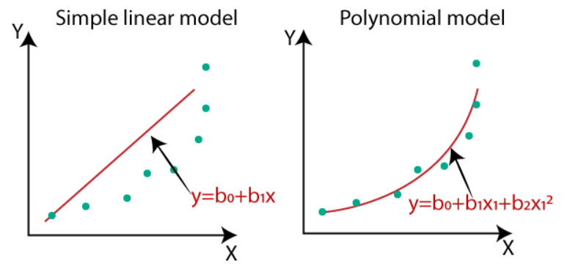
Simple Linear VS Polynomial Regression

Slide 5
Equation of the Polynomial Regression Model:
Simple Linear Regression equation:
y = b₀+b₁x
Multiple Linear Regression equation:
y= b₀+b₁x+ b₂x₂+ b₃x₃+....+ b_{n}x_{n}
Polynomial Regression equation:
y= b₀+b₁x + b₂x²+ b₃x³+....+ b_{n}x^{n}
In the equation, y is the dependent variable, xx is the independent variable, and b₀ – b_{n}​ are the parameters you can optimize.

Slide 6
Important considerations
Order of the polynomial model
Model-building strategy
Extrapolation
lll-conditioning
Hierarchy

Slide 7
Order of the polynomial model
First, remember that it is always possible to fit a polynomial model of order n − 1 perfectly to a data set n points (however, this will almost surely be overfitting!!!)
Transformations should be tried first to keep the model first order.
A low-order model in a transformed variable is almost always preferable to a high-order model in the original metric.
One should always maintain a sense of parsimony, that is, use the simplest possible model that is consistent with the data and knowledge of the problem environment

Slide 8
Model-building strategy
There are two standard procedures for building a polynomial model:
Forward selection: Successively fit models of increasing order until the t-test for the highest order term is nonsignificant.
Backward elimination: Appropriately fit the highest order model and then delete terms one at a time, starting with the highest order, until the highest order remaining term has a significant t statistic
Interestingly, these two procedures do not necessarily lead to the same model

Slide 9
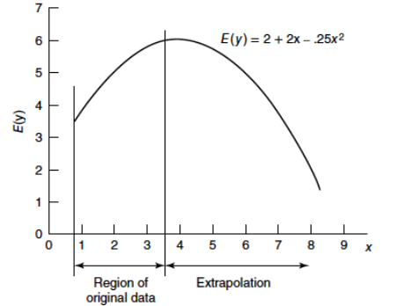
Extrapolation
Because polynomial models may turn in unanticipated and inappropriate directions, extrapolation with them can be extremely hazardous.

Slide 10
lll-Conditioning
In the setting of polynomial regression, the design matrix may have lots of columns corresponding to just one predictor or two.
Those columns will have significant multicollinearity, especially when the values of x are limited to a narrow range.
As the order of the polynomial model increases, X’ X becomes more and more ill-conditioned, meaning that matrix inversion calculations are more and more inaccurate.

Slide 11

Hierarchy
The regression model
is said to be hierarchical since it contains all terms of order 3 and lower. In contrast, the models
are not hierarchical.

Slide 12
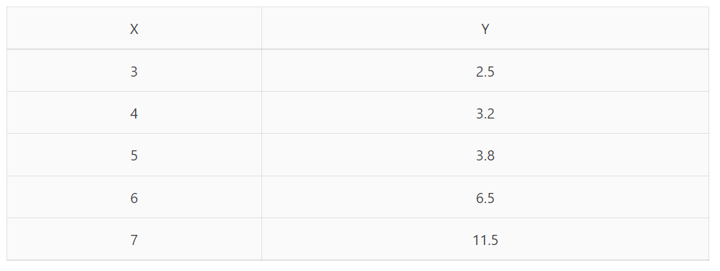
Problem
Find a quadratic regression model for the following data:

Slide 13
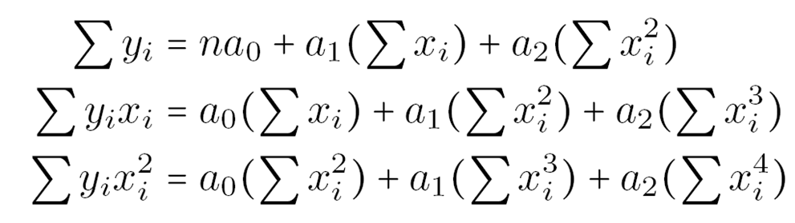
Let the quadratic polynomial regression model be
y=a₀+a₁*x+a₂*x²
The values of a₀, a₁, and a₂ are calculated using the following system of equations:

Slide 14
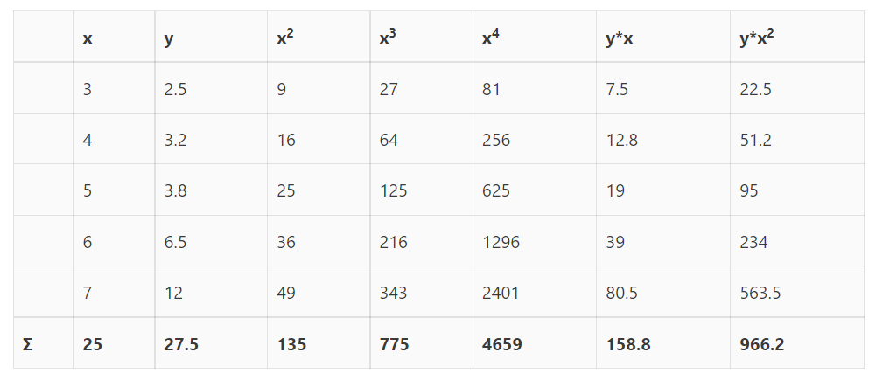
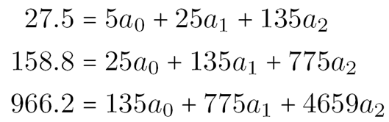
Solving this system of equations we get
a₀=12.4285714
a₁=-5.5128571
a₂=0.7642857

Slide 15
The required quadratic polynomial model is
y=12.4285714 -5.5128571 * x +0.7642857 * x²

Slide 16
Where is polynomial regression used in machine learning
Death rate prediction
Tissue growth rate prediction
Speed regulation software

